Slide 1


BES171: Banking, Finance & Insurance
Money Evolution
Monetary Policy
Evolution & Classification of FI
Digital Payment
BASEL, NPA, TBS, Bad Bank-PARA
Finance, Insurance & Fin.
Incl. MP1_FY18

Slide 2
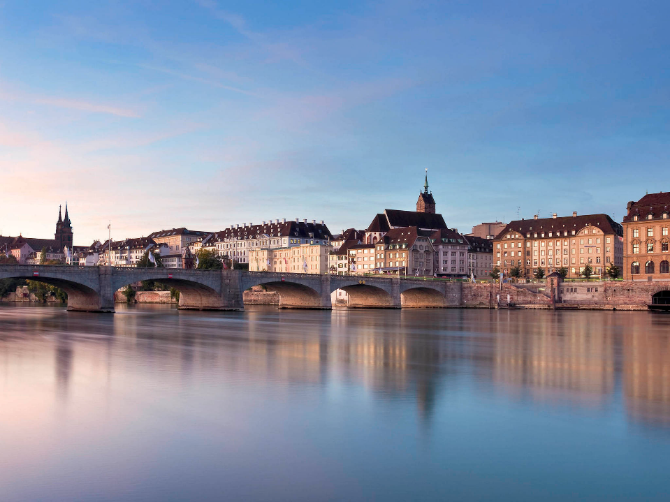
BASEL-III Norms
CRAR (9%)
CCCB
Counter cyclic capital buffer?
“recapitalization”
+ RBI’s PCA framework against Weak Banks
Basel, Switzerland

Slide 3




In the beginning
Assets
CRR & SLR: 25 cr.
Liability
Capital:100 cr
NDTL: 100 cr.
Loans: 75 cr.

Slide 4
Suppose loans turn NPA, and deposits stop coming..?
Assets
CRR & SLR: 25 cr.
Liability
Capital:100 cr
NDTL: 100 cr.
NPA: 75 cr.
Give me my money back!!!

Slide 5
Suppose loans turn NPA & new deposits stop coming.
Assets
CRR & SLR: 25 cr.
Liability
Capital:100 cr
NDTL: 100 cr.
NPA: 75 cr.
Rs. 25 cr paid
Rs. 75 cr. pending

Slide 6
Suppose loans turn NPA
BASEL Norms for Capital to risk weighed asset ratio
Therefore banks need adequate capital base
Assets
CRR & SLR: 25 cr.
Liability
Capital:25 cr
NDTL: 100 cr.
NPA: 75 cr.
Rs. 25 cr from CRR, SLR
Rs. 75 Cr. From capital

Slide 7
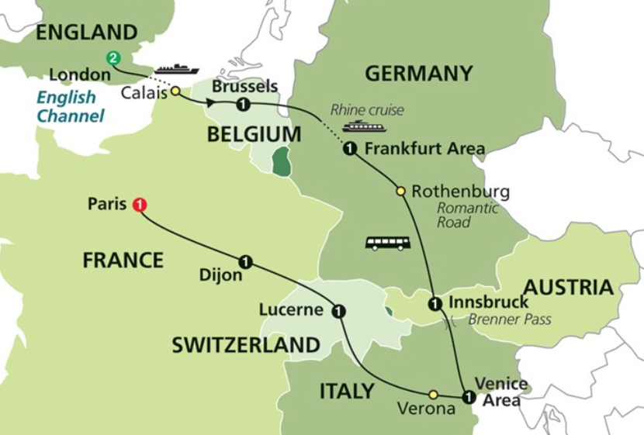
Bank of International Settlement (owned by 60 Central Banks)
Committee on banking supervision- @Basel, Switzerland
BASEL I: 1988
BASEL II: 2004
BASEL III: 2011
Notes:
NEFT because both banks have current account in RBI

Slide 8
Formula wrong, just for illustration
Asset | Amt (Cr.)
SLR & CRR | 25
Home Loan | 10
PSL (agri, etc.) | 40
NPA | 25
Total | 100
Liabilities
Time
Demand
Other
Total 100 cr.

Slide 9
Formula wrong, just for illustration
Asset | Amt (Cr.) | Risk Wt
SLR & CRR | 25 | 52%
Home Loan | 10 | 110%
PSL (agri etc.) | 40 | 120%
NPA | 25 | 192%
Total | 100 | RWA:

Slide 10
Formula wrong, just for illustration
Asset | Amt (Cr.) | Risk Wt | Total (Amt * Wt)
SLR & CRR | 25 | 52% | 13
Home Loan | 10 | 110% | 11
PSL | 40 | 120% | 48
SMA/NPA | 25 | 192% | 48
Total | 100 | RWA: | 120

Slide 11
For BASEL-III: capital to risk weighed asset ratio must be 9%
banks need adequate capital base
Assets
Risk weighted assets: 120 Cr.
Liability
Min. Capital: ? Cr.
NDTL: whatever

Slide 12
BASEL norms: capital to risk weighed asset ratio must be 9%
Capital 9
CRAR 9%
RWA 100
10.8
Capital ??
CRAR 9%
RWA 120
PSB: Capital 9+ __=10.8
CRAR 9%
RWA 120

Slide 13
BASEL norms: capital to risk weighed asset ratio must be 9%
Capital 9
CRAR 9%
RWA 100
10.8
Capital ??
CRAR 9%
RWA 120
Hint: 120 x 0.09
PSB: Capital 9+ __=10.8
CRAR 9%
RWA 120

Slide 14
BASEL norms: capital to risk weighed asset ratio must be 9%
Capital 9
PSBs require 1.8 lakh crore addl. Capital to comply with BASEL-III
CRAR 9%
RWA 100
10.8
Capital ??
CRAR 9%
RWA 120
PSB: Capital 9+ __=10.8
CRAR 9%
RWA 120

Slide 15


For BASEL-III: capital to risk weighed asset ratio must be 9%
All PSBs, collectively require 1.8 lakh crore
Recapitalization
“Indradhanush”
70k cr.
Assets
Risk weighted assets: 120 lakh Cr.
Liability
Min. Capital: 10.8 lakh Cr. by 2019, 31st March
NDTL: whatever
Capital market:
Preferential shares, bonds: 1.1 lakh cr.

Slide 16

BASEL-III Recapitalization of PSB by 2019, 31st March
Govt: 70kCr (IndraDhanush, depending on performance)
+ Capital Market 1.1 Lcr.
1.8 Lcr. needed
PSB have 9+ ___
10.8 needed
Capital: ___?
9% CRAR for BASEL-III
RWA: 120 LCr
Notes:
7th PC : First two years salary? Some say equity with 5.1% return minus 0.1% as Administrative charge?

Slide 17

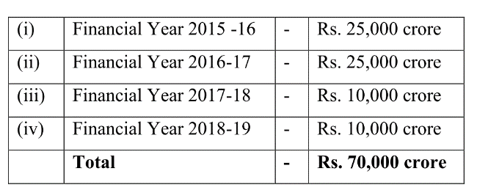
Public Sector Banks
10k crore for recapitalization,
Addl. May be given if required in “Indradhanush roadmap”.
Demonetization windfall profit
Although FRBM Panel (NK Singh) says this is insufficient. But that Committee report we’ll see in “second pillar” (Public finance)

Slide 18


Recapitalization: addl. 1.8 lakh cr. by 31/03/2019
Equity (Owners/ Proprietors)
Bonds/Debentures/Loan
Must pay interest, principal irrespective of profit / loss
Partnership, IPO-Shares, VCF, Angel Investor
Dividend if profit
Last claim during liquidation
First claim during liquidation
Debt (Creditors)
Addl. Capital 1.8 lakh cr.
Govt employees’ 7th PC award- 50% of increased salary be given in form of bonds “Capitalization Bonds”; optional for pensioners & lower staff
70kcr Preferential shares to govt. (Indradhanush)
1.10 Lakh cr. remains
PSB can issue FPO, but govt. shareholding must remain >50% (Except IDBI). Problem: due to NPA, bank share prices down
Notes:
Get firm commitment from client for SMA=>Regular Account
Get addl. investors if possible
Give addl. Loan if required but must not ‘ever-green’
No changes in tenure/interest rate

Slide 19

BASEL: Min. Capital to Risk weighed Assets Ratio 9%
RBI: 7% of RWA must be in Tier1
List not exhaustive
Tier1
Common shares
Tier2
Debt (Bonds)
Preferential shares
Hybrid instruments
Capital T1+T2
Capital
9% CRAR
RWA:

Slide 20


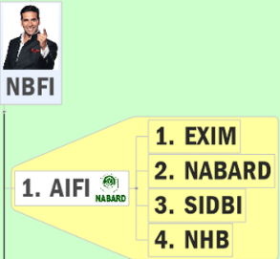


BASEL-iii compliance on CRAR?
BASEL III: 2011
AIFI
1/1/18
Banks
31/03/19
Until now, under BASEL-I but..
SCB: 9%
SFB & PB
15%

Slide 21
BASEL-III seeks to …..
UPSC Pre-2015
Develop national strategies for biological diversity
reduce the GHG emissions but places a heavier burden on developed countries
transfer technology from developed Countries to poor countries to replace chlorofluorocarbons in refrigeration
improve banking sector's ability to deal with financial and economic stress and improve risk management
Though UPSC asking such Pedestrian questions, I taught in detail because next topics (NPA, farmer debt waiver, PARA etc.), will require finer understanding of BASEL

Slide 22
BASEL-III Norms
CRAR (9%)
CCCB
Counter cyclic capital buffer?
“recapitalization”
+ RBI’s PCA framework against Weak Banks
Basel, Switzerland

Slide 23
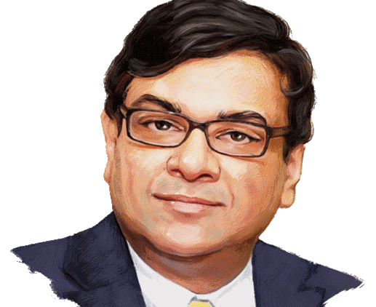


Countercyclical capital buffer norms (CCCB)
2009-11
2017, April
BASEL- CCCB, CRAR
2015, April
Norms
No need as of now.

Slide 24
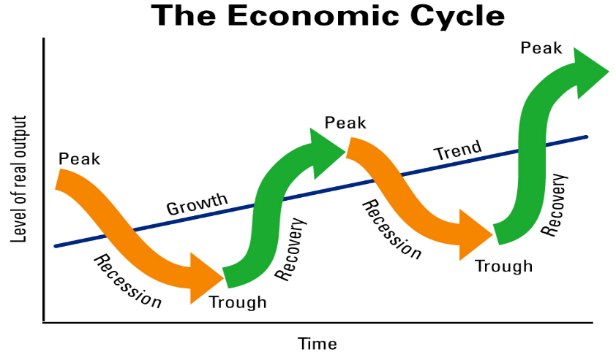
So, better create a buffer in boom, to use in bust
Boom: excess lending: subprime crisis, TBS
Bust: shortage of funds

Slide 25


BASEL: Min. Capital to Risk weighed Assets Ratio 9%
But we don’t need it for the moment, said Dr. Patel = 1) next year no ‘boom’ 2) may be banks not capable since even struggling with CRAR compliance!
0%-2.5% of RWA CCCB as common shares
But RBI must notify 4 quarters ahead
Tier1
Common shares
Tier2
Debt (Bonds)
Preferential shares
Hybrid instruments
Capital T1+T2
Capital
9% CRAR
RWA:
Notes:
Rule made in 2009, post GFC (2008)
During GDP growth-> set aside certain capital as "Buffer" for bad times. [will also prevent indiscriminate overlanding.]
During GDP fall, use that amount for lending.
This buffer In Common equity Tier-1, IF RBI feels the need.
0-2.5% of RWA [9% toh kharuj.]
RBI To notify 4 quarters in advance.
Group of Central Bank Governors and Heads of Supervision (GHOS).
GHOS supervise the BASEL-Committee rules.

Slide 26
UPSC Prelim Mock Question
Under the BASEL-III norms, RBI can make rules for:
Capital to risk weighted assets ratio (CRAR)
Countercyclical Capital Buffer (CCCB)
Both A and B
Neither A nor B

Slide 27
BASEL-III Norms
CRAR (9%)
CCCB
Counter cyclic capital buffer?
“recapitalization”
+ RBI’s PCA framework against Weak Banks
Basel, Switzerland

Slide 28
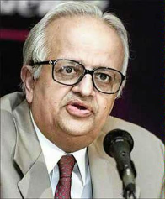
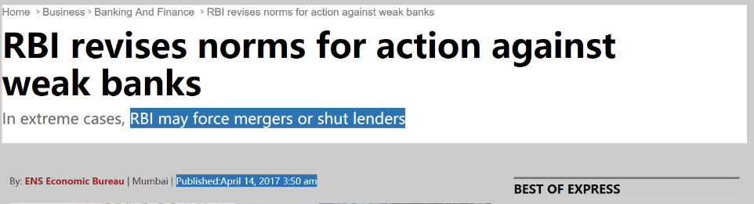
Prompt Corrective Action framework (PCA)
2002
RBI Gov Bimal Jalan
2017, April
Further tightened

Slide 29
Prompt Corrective Action framework (PCA)
Risk threshold..
Parameter
NPA
BASEL Capital
Profitability
#1
#2
#3
Leverage
Restriction on Directors’ salaries, Dividend distribution
Restriction on branch expansion
Forced MERGER or shutting down of weak banks (discretionary)

Slide 30
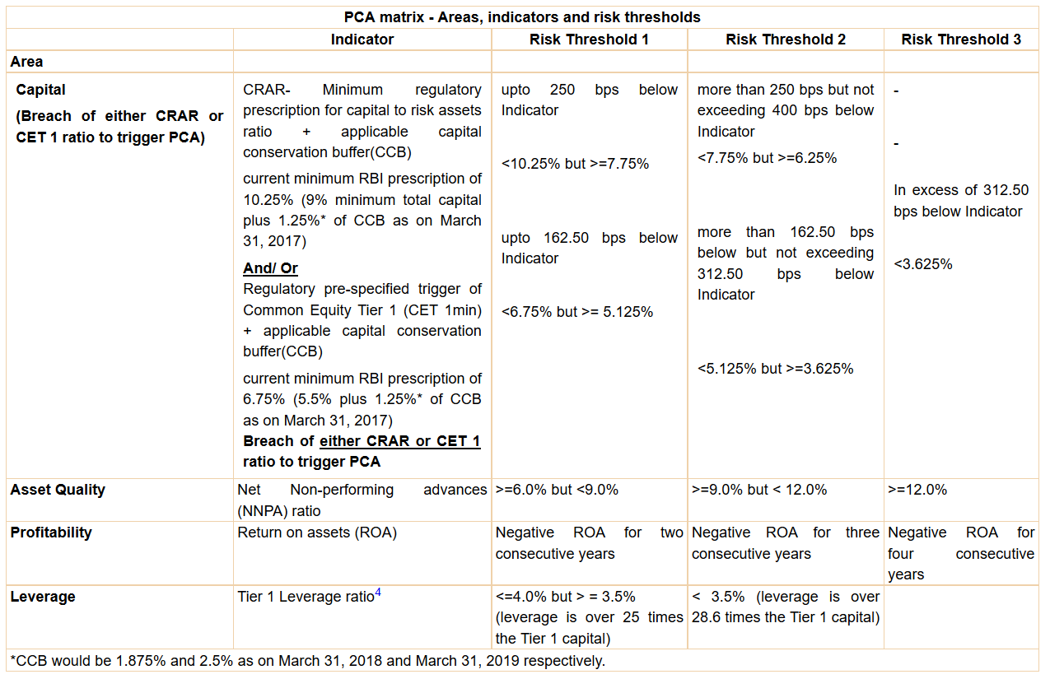


Slide 31
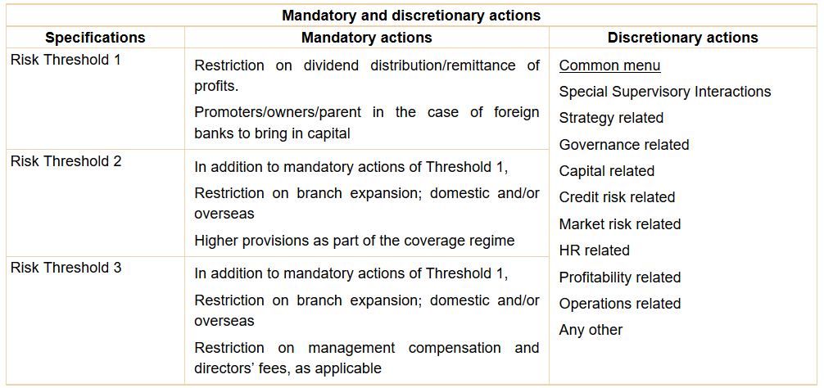
More details:
https://rbi.org.in/scripts/NotificationUser.aspx?Mode=0&Id=10921

Slide 32
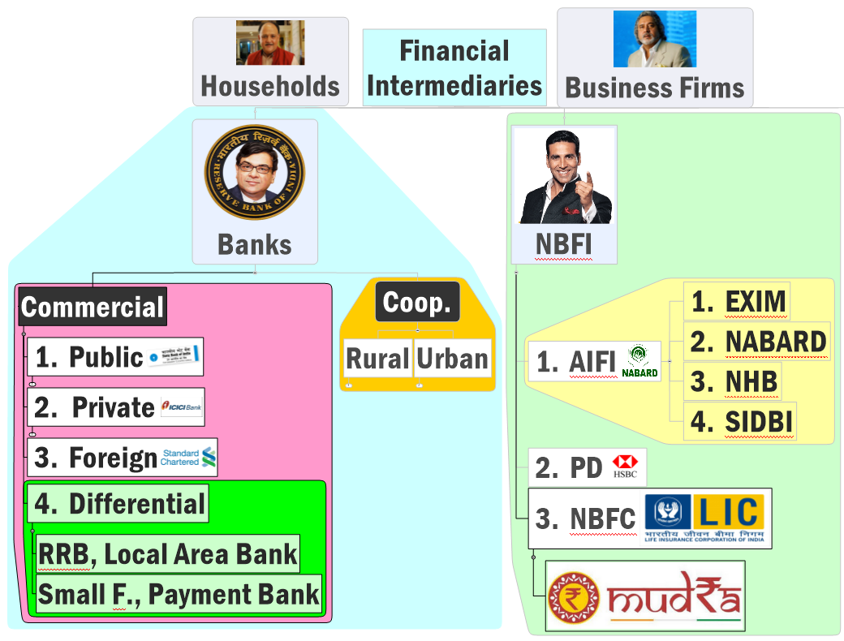


PCA applicable on whom?
All SCB except RRB

Slide 33
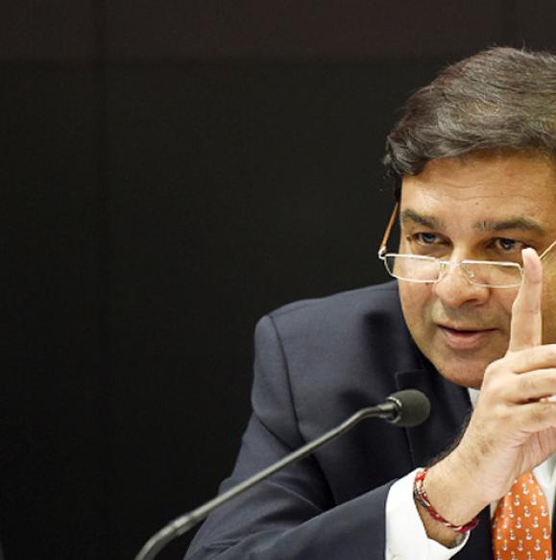

Monetary Policy: Tools
Where should I put PCA framework?
Volume of credit
Quantitative/Gen./Indirect
Qualitative: Selective, Direct
Reserve Ratios (CRR, SLR)
OMO & MSS
Rates: Bank, MSF, LAF [Repo, RR]
Selective Credit Control (SCC), PSL: Credit Rationing, Subsidy [fiscal policy]
Moral Suasion
Direct Action
+review of last one year’s policies
Consumer Credit control / EMI
Margin / LTV
Distribution of credit
Under Banking regulation Act 1949..
PCA framework

Slide 34
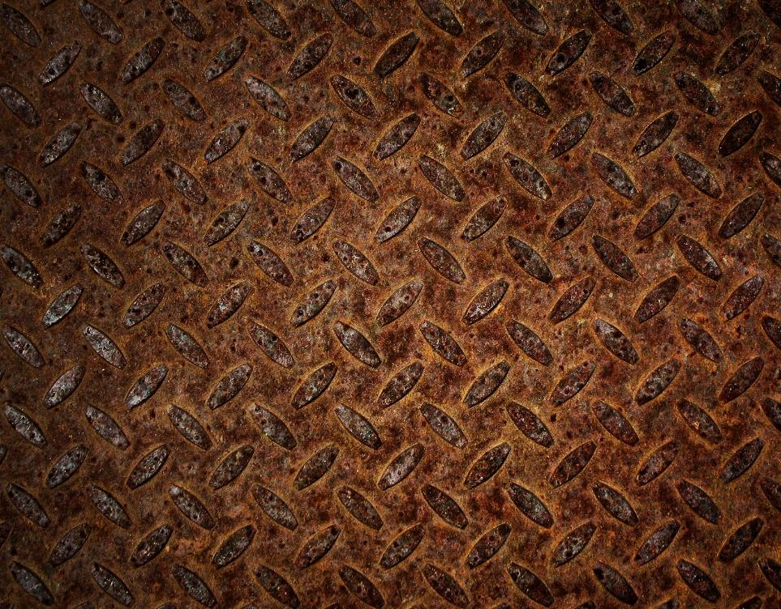
NEXT: Economic Survey Ch4: Festering TBS, NPA problem
Genesis: 3 Stage
3 R, SDR, S4A
I&B Code 2016
PARA-Bad Bank
Windfall Profit
Moral Hazard 4R4D

